Slide 1

AML-2304 Natural Language Processing
Lambton College
School of Computer Studies
[Prepared By: Vahid Hadavi, PhD]

Slide 2
Module 7 7. Discriminate Parsing Structure in Text
Major Topics:
7.1 Describe Chunking (Shallow Parsing)
7.2 Discuss Chinking as an extension of Chunking

Slide 3
7.1 Describe Chunking (Shallow Parsing)

Slide 4
Syntactic parsing
Syntactic parsing refers to a technique by which tokenized, segmented and part-of-speech segmented text is assigned a structure revealing the relationship between tokens
It is usually done as the first step in deep information extraction and semantic understanding of a text.
Syntactic parsing methods usually suffer from structural ambiguity, which means that we could have more than one correct parse trees for one sentence.
This may present a challenge to selecting the most likely parse for the sentence.
One of the best syntax parser that supports differnt languages is the blackbox established by Stanford’s CoreNLP Library.
It is a Java library and it requires to have installed Java 1.8

Slide 5
Chunking (Shallow Parsing)
Chunking refers to the process of identifying the constituent parts of a sentence such as a verb, nouns, adjectives, etc.
These constituents are then linked to the higher order units with discrete grammatical meanings such as noun groups, verb groups, etc.
The purpose of chunking is to break down a text into groups that are more meaningful.
These groups are known as noun phrases (NP).
The idea is to group the words in such a way that the related words are grouped together.
The group of words that you create from chunking is known as chunks

Slide 6
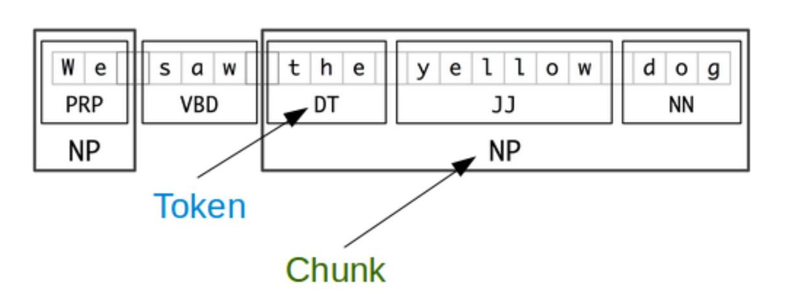
Chunking (Shallow Parsing)
The smaller boxes show the word-level tokenization and part-of-speech tagging
The large boxes show higher-level chunking.
Like tokenization, which omits whitespace, chunking usually selects a subset of the tokens.
Also like tokenization, the pieces produced by a chunker do not overlap in the source text

Slide 7


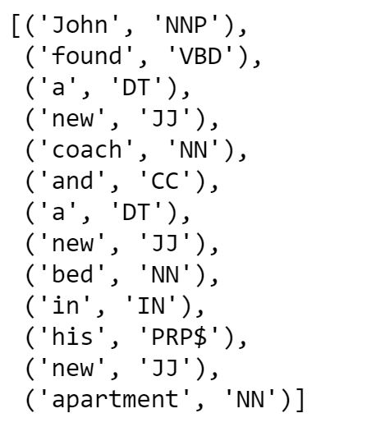
Chunking (Shallow Parsing)

Slide 8


Chunking (Shallow Parsing)
We can use chunk.RegexpParser() on NLTK to chunk a text.
It is a grammar- based chunk parser and uses a set of regular expression patterns to specify the behavior of the parser.
We are looking for zero or one determiner, followed by one or more adjectives followed by a noun.
Now we can use our parser on the output tags.

Slide 9
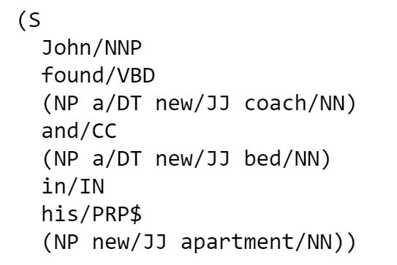
Chunking (Shallow Parsing)

Slide 10

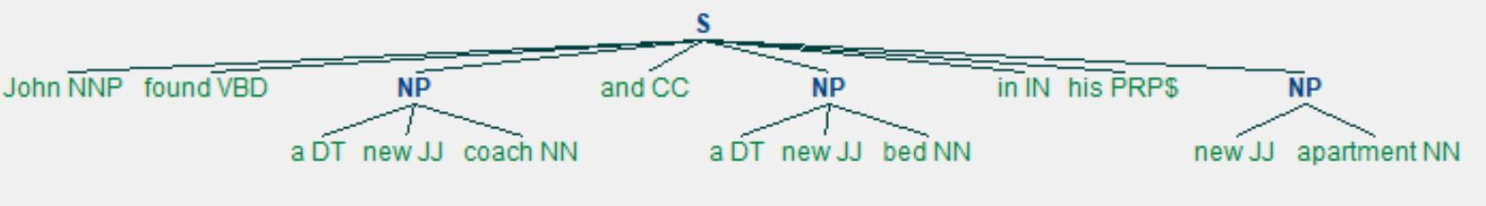
Chunking (Shallow Parsing)
We can draw the tree structure of the sentence

Slide 11
7.2 Discuss Chinking as an extension of Chunking

Slide 12
Chinking
After breaking down our text to chunks, we need to remove unwanted words from our chunks.
In such a case, chinking is used.
Chinking is simply a process that you use to remove a chunk from a chunk.
The chunk that is removed from the chunk is referred to as the chink.
we denoted the chunks using {}. To denote the chinks, we use }{ in the regular expression part.
If the matching sequence of tokens spans an entire chunk, then the whole chunk is removed.
If the sequence of tokens appears in the middle of the chunk, these tokens are removed, leaving two chunks where there was only one before.
If the sequence is at the periphery of the chunk, these tokens are removed, and a smaller chunk remains.

Slide 13
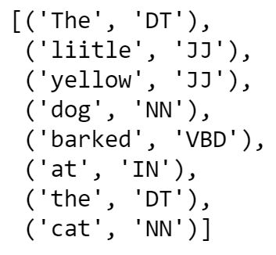
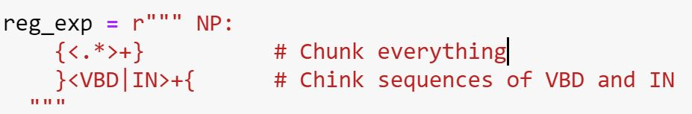
Chinking
We want to chuck everything and chink any sequence of a verb followed by a preposition.

Slide 14
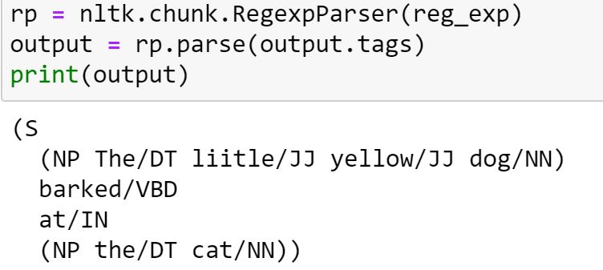
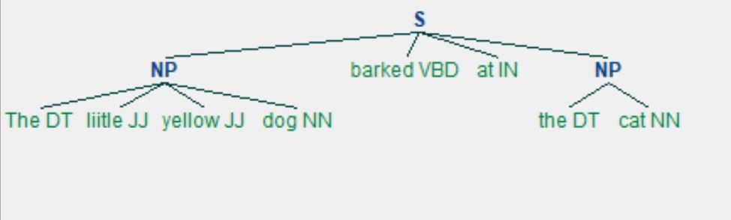
Chinking

Slide 15
Any questions so far? Any comments?

